Slide 1
Drift Detector
CS6620 Final Project
—-- Anushka Doshi

Slide 2
01
The Core Problem…
Infrastructure-as-Code declares a desired state, but live cloud infrastructure quietly drifts from it (a console tweak, an automated change, a manual fix that never makes it back to Terraform).
This drift is a silent security risk. A bucket made public or SSH opened to 0.0.0.0/0 can sit unnoticed until it's exploited or breaks the next deploy.
Terraform plan catches drift but only when a human runs it, leaving gaps of hours or days between manual checks.
The real need isn't one-time detection but it's continuous, automated monitoring with history and alerting, so drift surfaces in minutes, not whenever someone remembers to look.

Slide 3
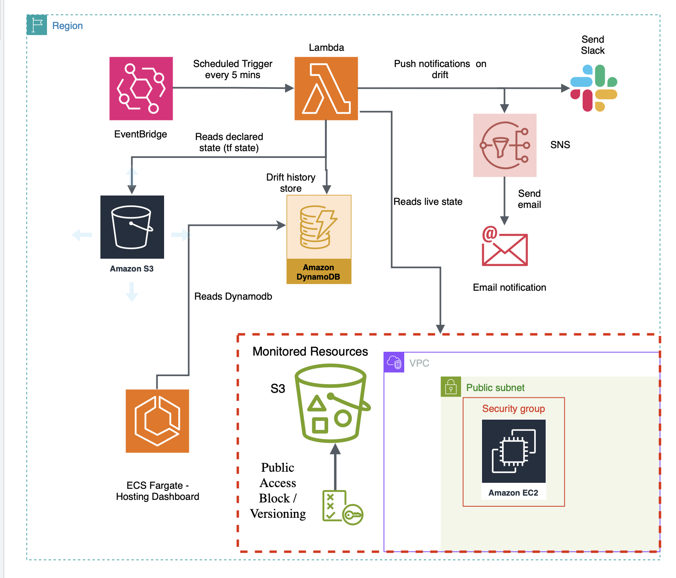
The Solution…
02
A scheduled Lambda (EventBridge, every 5 min) reads Terraform state from S3, queries live AWS via boto3, and diffs them per resource
Compares Terraform state (recorded desired state) against live reality and not .tf code against reality
Drift is recorded in DynamoDB (full history + lifecycle) and alerts fire via SNS email and Slack
A dashboard reads DynamoDB to show what's drifting now, what resolved, and each resource's timeline

Slide 4
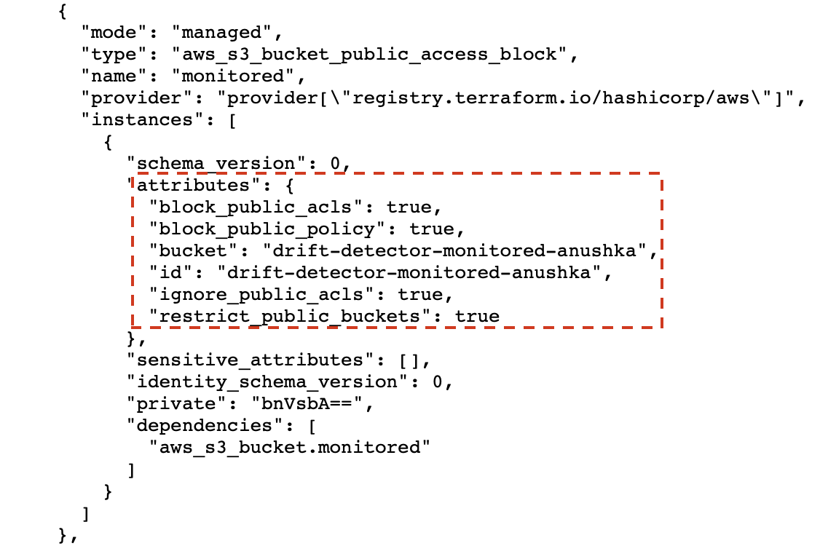
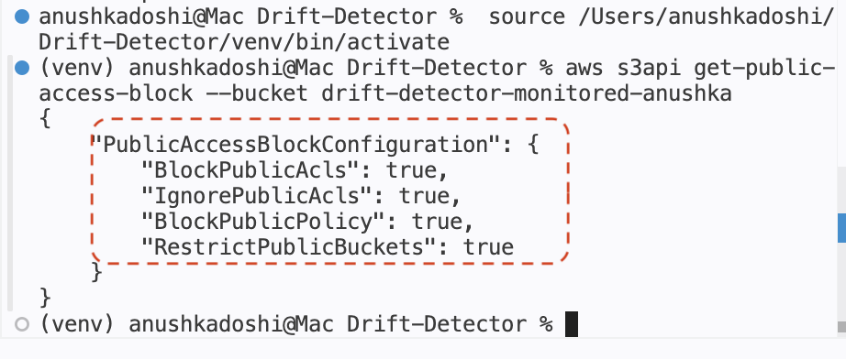
The Challenges…
03
Name_case V/s NameCase
Terraform State file
Live AWS API response

Slide 5
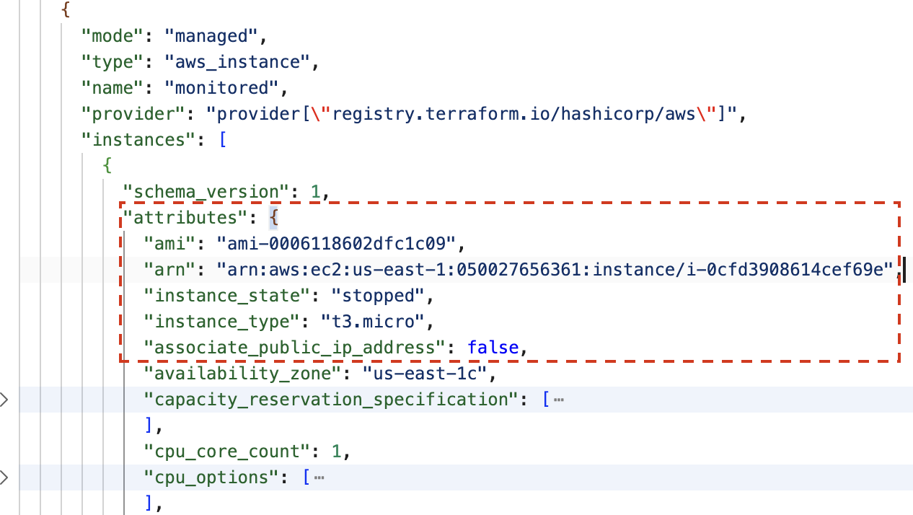
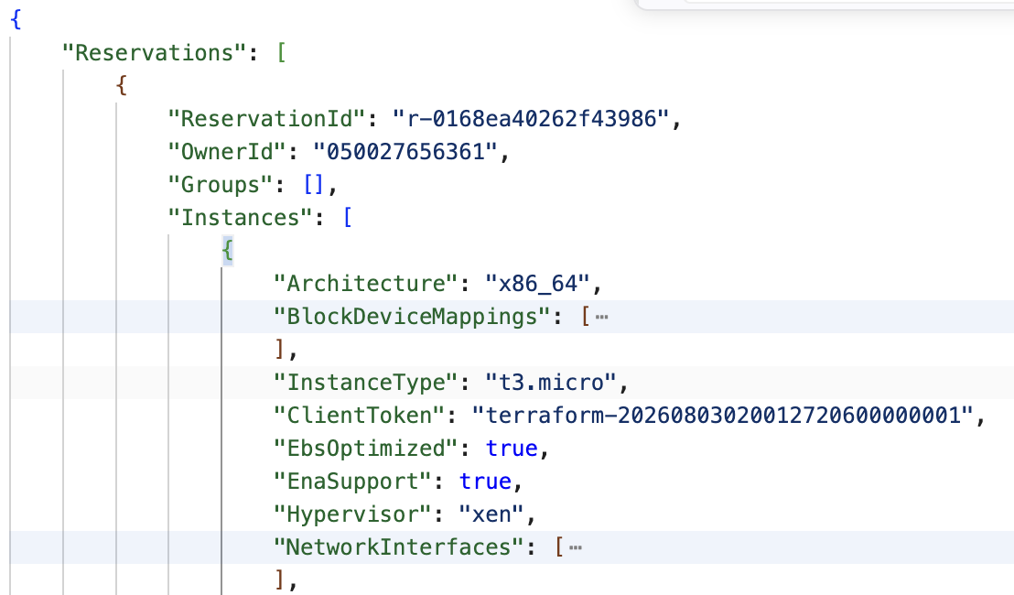
The Challenges…
03
Structural Path Mismatch
Terraform State file
Live AWS API response

Slide 6
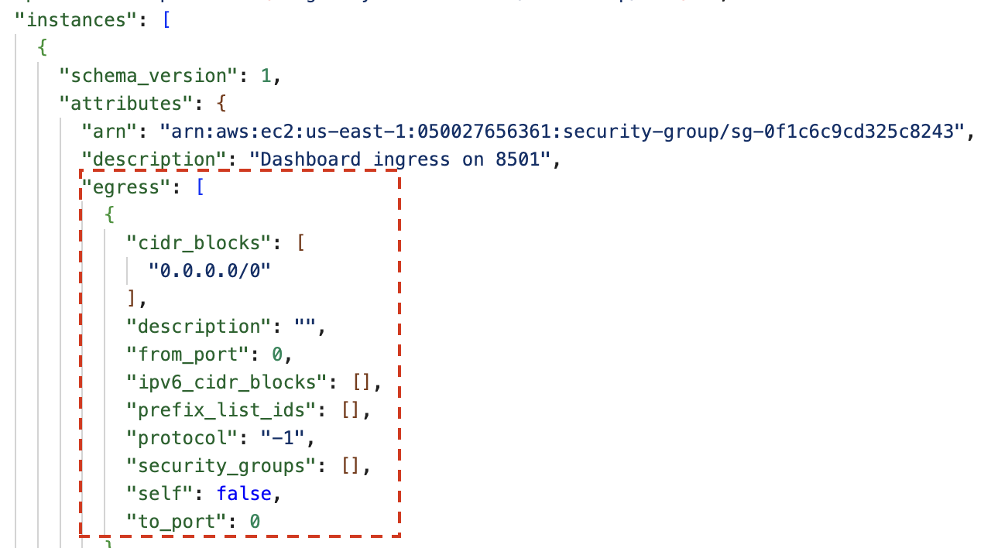
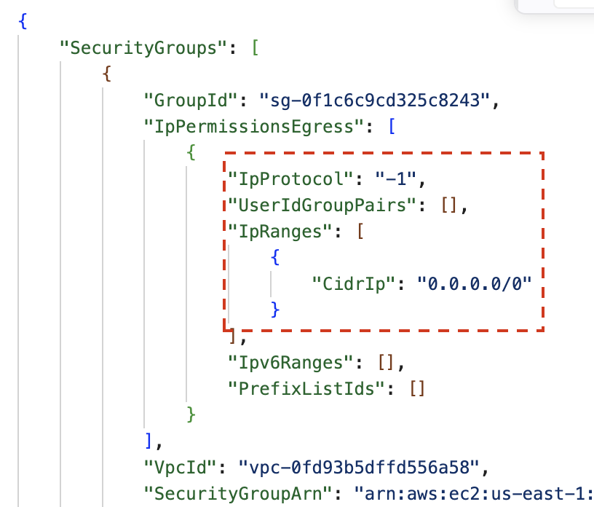
The Challenges…
03
Unordered Structural Data
Terraform State file
Live AWS API response

Slide 7
The Architecture
04
Config for the Common Case, Code for the Structural Case
A YAML config declares what to monitor - no code changes for common case
Examples - Resource types, attributes, name mappings, and where values live
A dynamic engine handles the mechanics generically
Builds the right boto3 client, calls the right API, and diffs declared vs. live for any scalar resource.
A Python handler is written only when comparison is genuinely structural
Like security-group rules, where unordered lists of objects can't be expressed in config
Resources are discovered from the Terraform state file, never hardcoded
Add a resource in Terraform and it's monitored automatically.

Slide 8
The Architecture Pays Off…
New attribute on an existing type → one line of YAML, zero code.
New scalar resource type (S3 versioning, EC2 instance type) → a config block, zero new comparison logic.
New structural type (security groups) → one ~40-line handler, isolated from everything else.
One engine, one config format → Multiple resource types with support for different aspects & attributes.
Each resource tracked as a FIRING → RESOLVED lifecycle with history and throttled re-alerting.

Slide 9
Future Improvements…
05
Attribute drift to a user
Integrate CloudTrail to answer “who made this change, and when."
Broaden resource coverage
Integrate Add IAM, RDS type resources to the tool. Easy add due to architecture.
Make it production ready
Create a stable dashboard URL behind Load balancer, CI/CD, and secrets management to move from MVP to deployable tool.
Detect unmanaged resources?
Catch things created entirely outside Terraform, not just drift on managed ones. Explore Driftctl.

Slide 10
Let's Cause Some Drift!

Slide 11
THANK YOU!!

